Slide 1
PDPE1 : PERSONAS + JOBS TO BE DONE
Volunteering and Donation Web Application
Saumya Roy, Hema Sree Tangella, Femina Maheshbhai Baldha , Vidisha Vijay Sawant , Evis Shehu

Slide 2
Title - Website for a non profit organisation which helps people to join volunteer groups and events around them.
Problem Statement - One of the biggest problems while looking for volunteering events and making donations is the lack of credibility of the organisation. People want to find a credible organisation or a platform which can help them participate in volunteering events and groups that can fit into their busy schedules so they can have a part in the causes they support.
Goal - Design a responsive website to help people to find and join volunteering events and groups around them.
Tool used - Figma

Slide 3
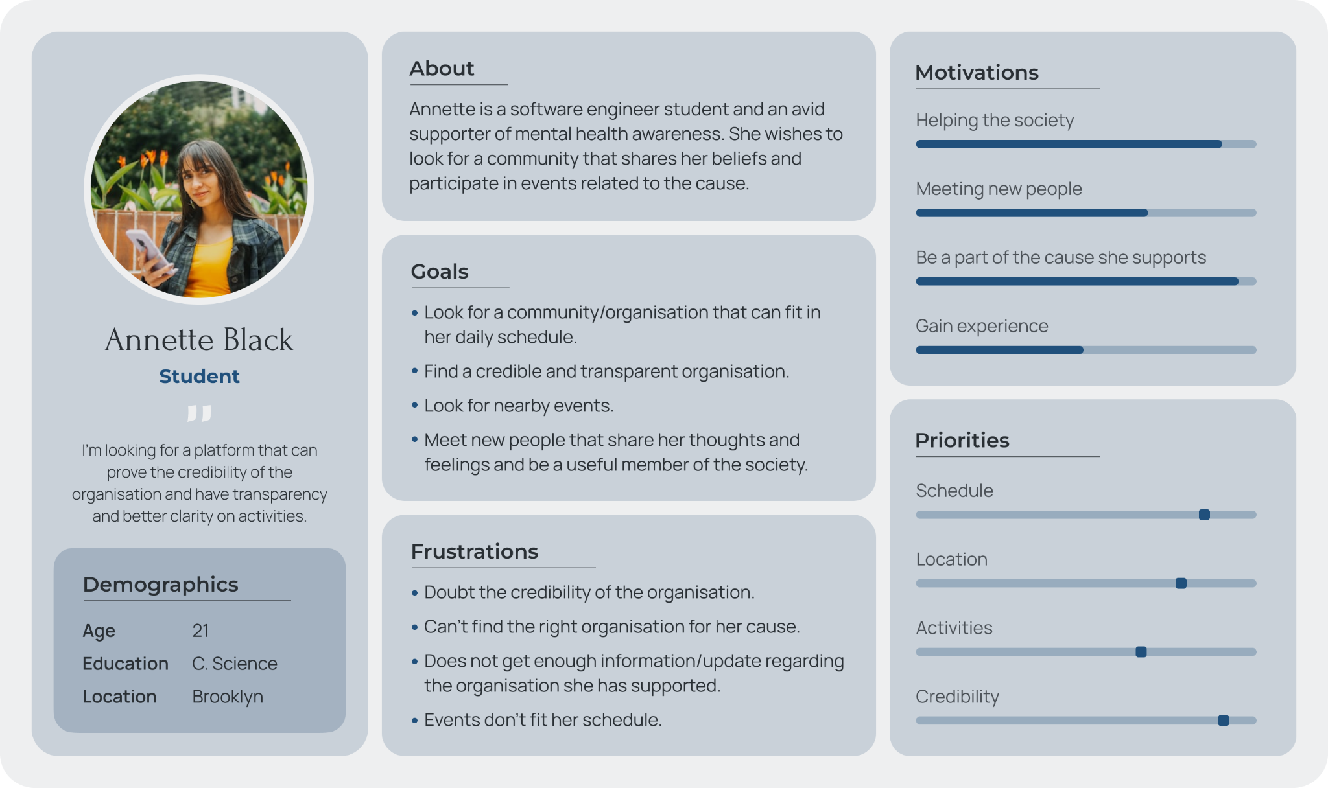
P
E
R
S
O
N
A
1

Slide 4
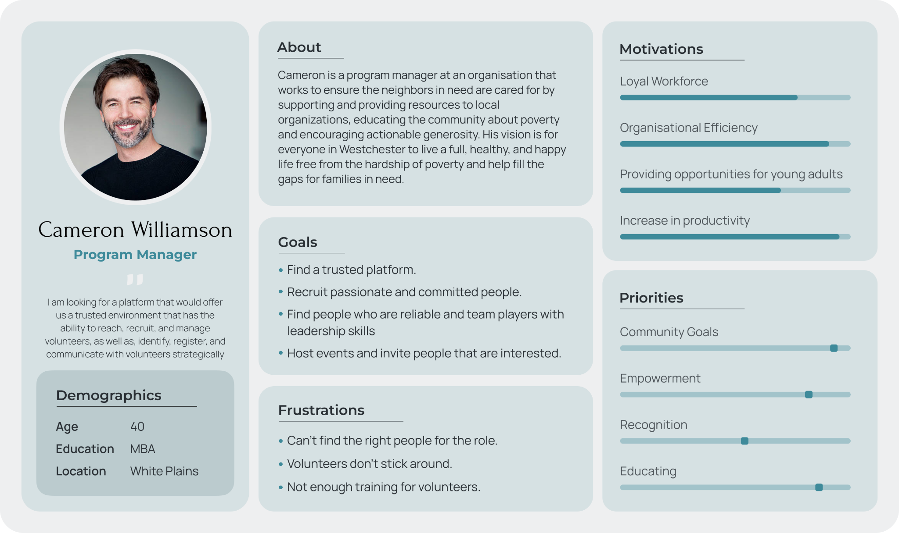
P
E
R
S
O
N
A
2

Slide 5
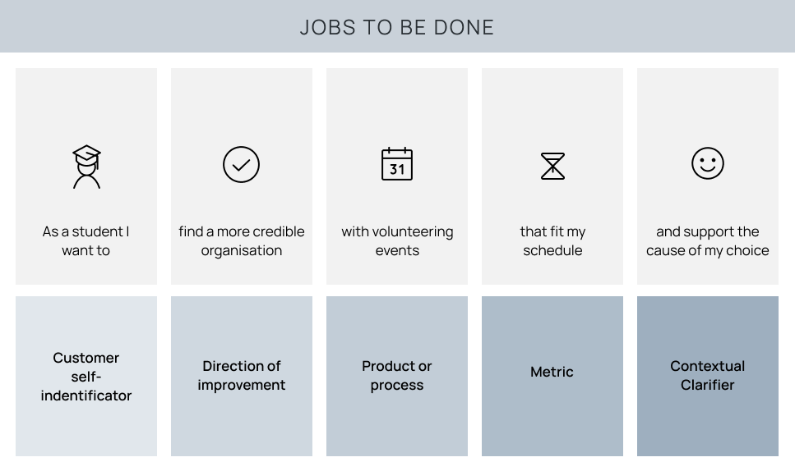

Slide 6
Data collection
The team collected data by interviewing 2 groups of individuals: people willing to volunteer and people working for a non-profit or charitable organization.
Volunteers
We aimed to understand people , how they volunteer for a cause, how often they donate and how much they are willing to help.
We collected the users data according to their profession which indirectly tells us about how much spare time they have for volunteering.
Non-profit or charitable organization
We aimed to understand how organizations reach to possible volunteers, recruit, and manage them.
How to maintain an on ongoing communication and involvement that would keep volunteers engaged in the long run.

Slide 7
Interview questions
We asked the participants a range of questions, some of them being:
Volunteers
Have you been associated with any volunteering work or non-profit before?
Have you donated money or supplies of any kind before?
Are you willing to volunteer during free time and weekends?
Were you confident enough to donate or do have doubts on credibility of organisation?
Non-profit or charitable organization
Where do you post events?
How do you recruit volunteers and what communication means do you use?
What technique do you use to find the right volunteer for the job? Do you train them?
What are your biggest challenges to keep volunteers engaged?
How do you showcase and ensure the honesty and credibility of your organization?

Slide 8
Interview analysis
Analyzing data collected through interviews helped us understand many viewpoints:
We have a general idea regarding people and how they like to volunteer and donate, the most preferred social causes supported, and how often they do so.
We got to know the problems people faced in past with volunteering, and awareness of the platforms available.
Main pain point which was emphasized by every participant, was the credibility and authenticity of the organization.
Organizations on the other hand, shed light on how they communicate volunteering needs and events, and how they recruit people.
Main pain point was volunteer empowerment and recognition in order to encourage people’s long term involvement with the cause.

Slide 9
Personas vs Jobs to be done
Personas helped us get an overall idea of our users and not just their goals but also their thoughts, feelings and motivations.
While both the methods are equally significant, for our problem statement we focus on 2 different user groups as portrayed in the personas. Personas help us focus on the users and their needs, and jobs to be done help us think in a user-centered way about the features of our product.
For our group and goal, we observed that personas helped us understand the users better.

Slide 10
User Needs and Problem Formulation
For our web application we had a challenge in defining the user needs for what our organization would need and how can the user trust whether the organization is true or not.
We also got to know various jobs we can do to solve the problems which were facing.
By the end of the exercise we were able to figure out the user needs as per our interviews and through them we were able to find what issues people and the organizations have. This helped us figure out our goals for the project that we can further work on.

